Slide 1
Examination system

Slide 2
AGENDA
Problem definition
Task breakdown
Solution steps

Slide 3
Problem
Build a full independent system for the students courses and generates their exams

Slide 4
Tasks breakdown
​Tasks | Work duration | Starting time​ | End time
ERD & Mapping Design | 7 days | First week | week 1
Scrape Exam Data | 2 days | Week 2 | Week 2
Write at least 4 procedure for every table | week | Week 2​ | 2 days from week 3
Generate SSRS Reports | 4 days | Week 3 | Week 3
Development Windows Application | 2 weeks | Week 2 | Week 4
Power bi dashboard | 3 days | Week 3 | Week 3

Slide 5
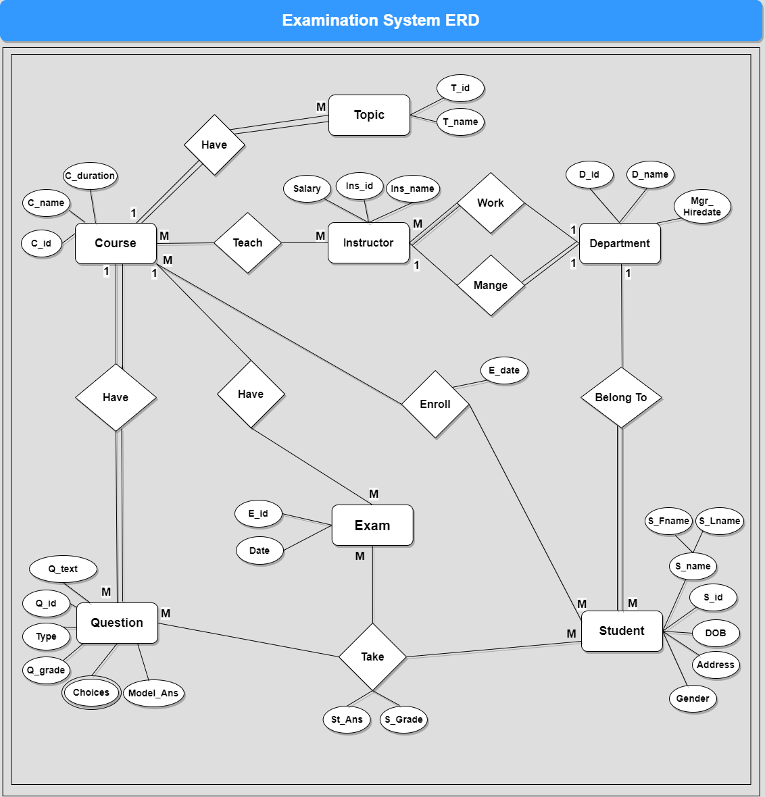
ERD & Mapping

Slide 6
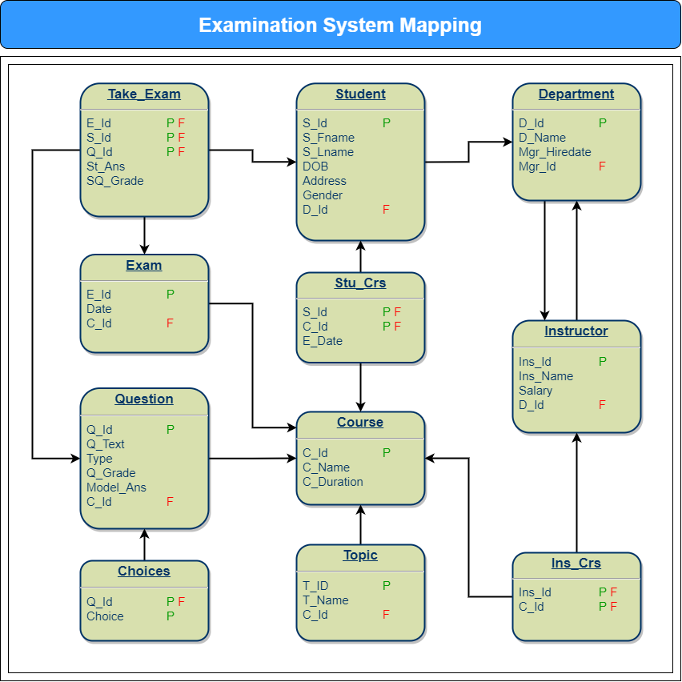
ERD & Mapping

Slide 7

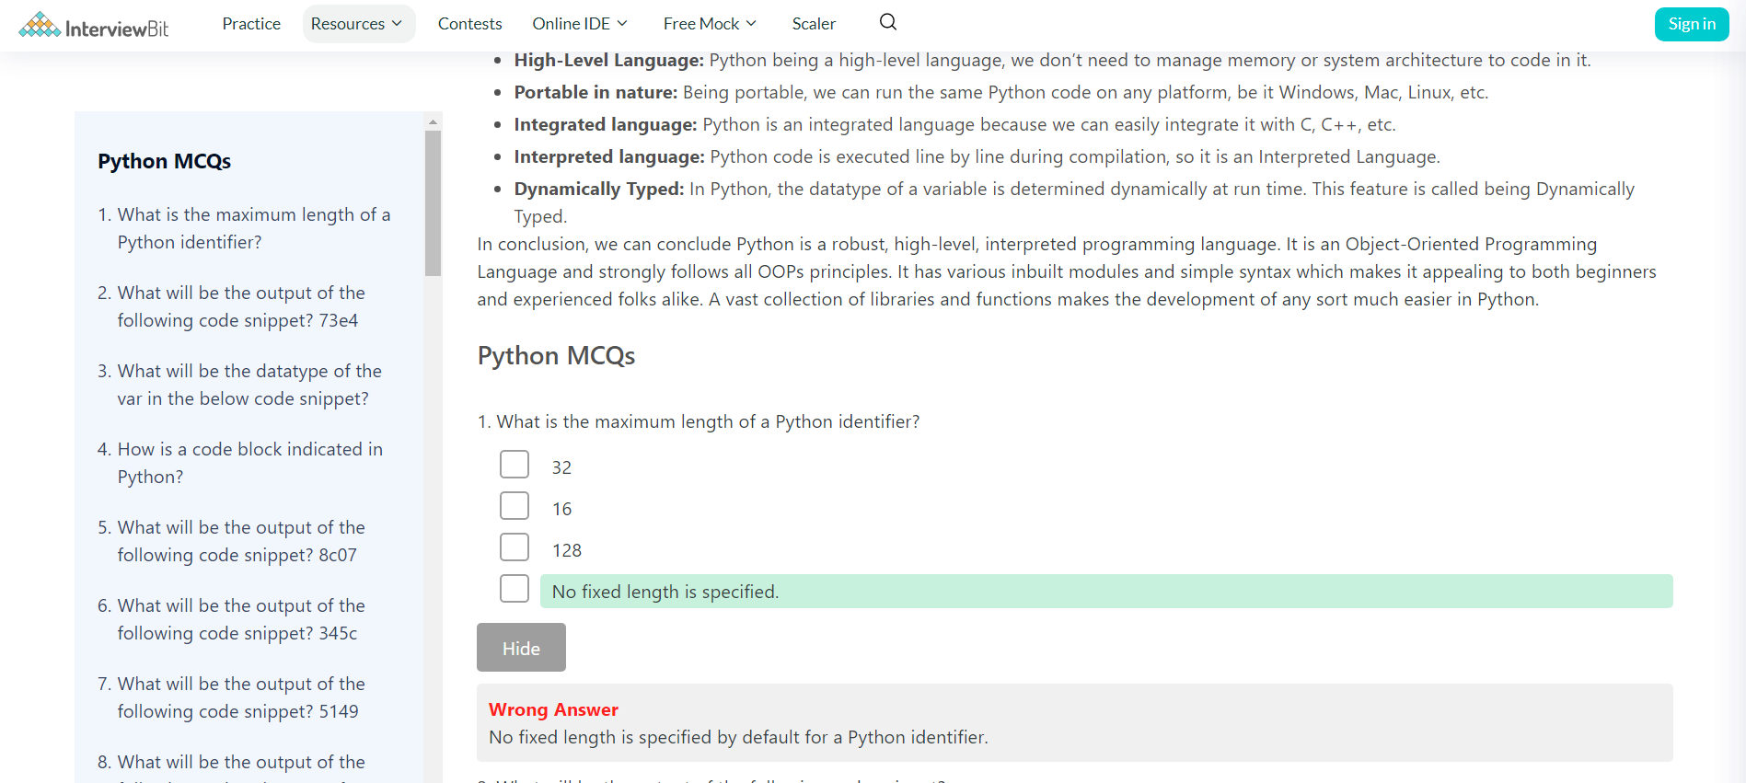
Web scraping

Slide 8
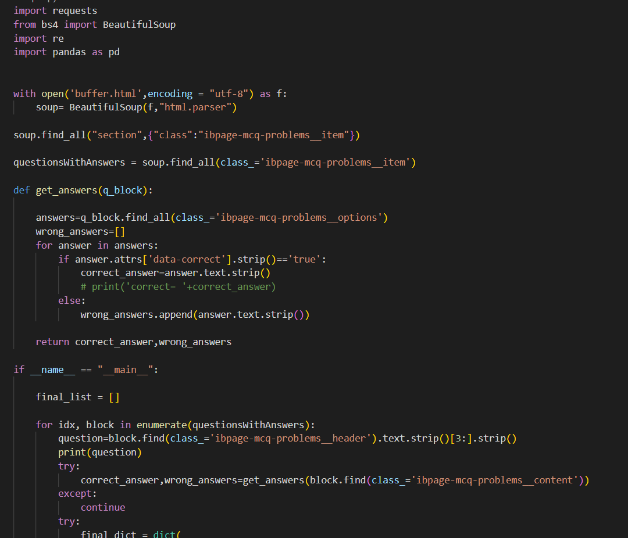
Web scraping

Slide 9
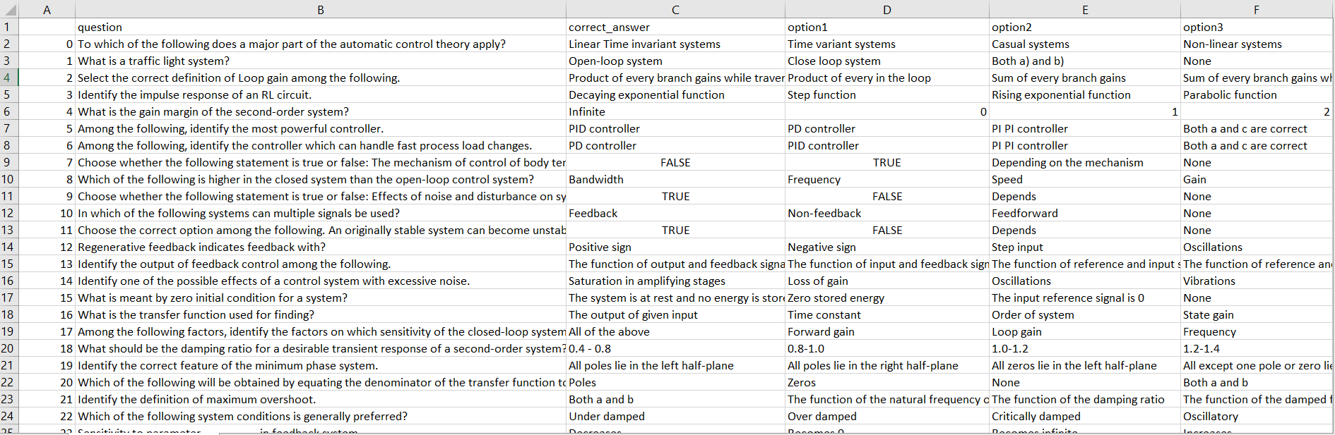
Web scraping

Slide 10
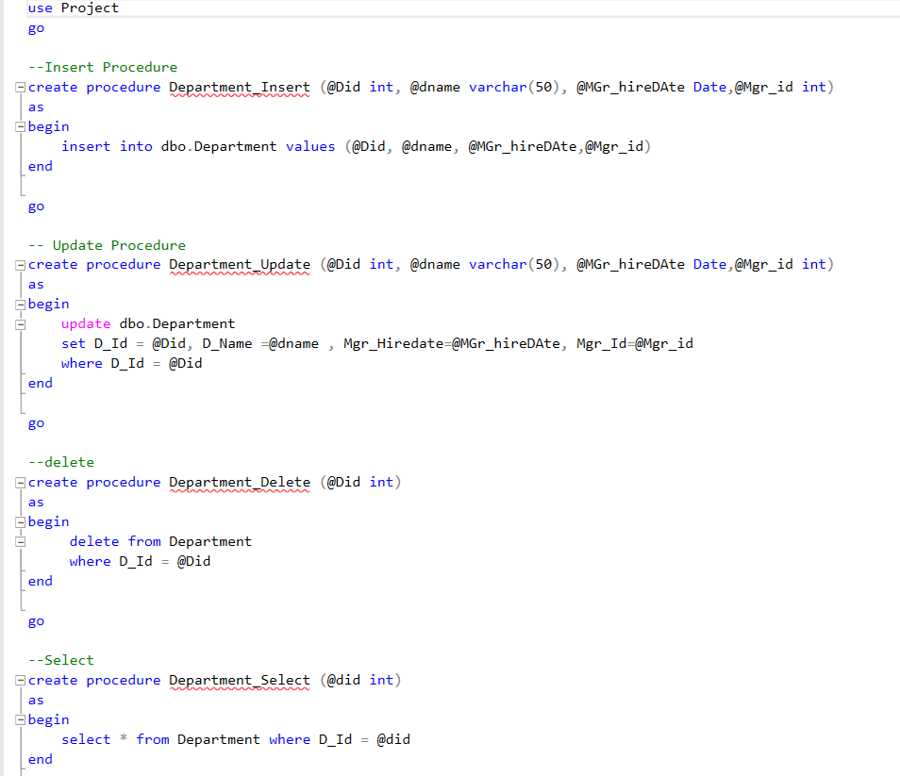
Stored procedures

Slide 11
Reporting
• Report 1 returns the students from Department Number.
• Report 2 returns the grades of the student.
• Report 3 returns courses name for every instructor and the number of students.
• Report 4 returns the topics
• Report 5 returns the Questions in it
• Report 6 returns the Questions in this exam with the student answer

Slide 12
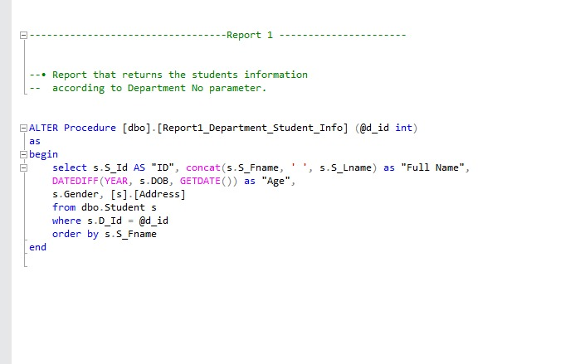
Reporting

Slide 13
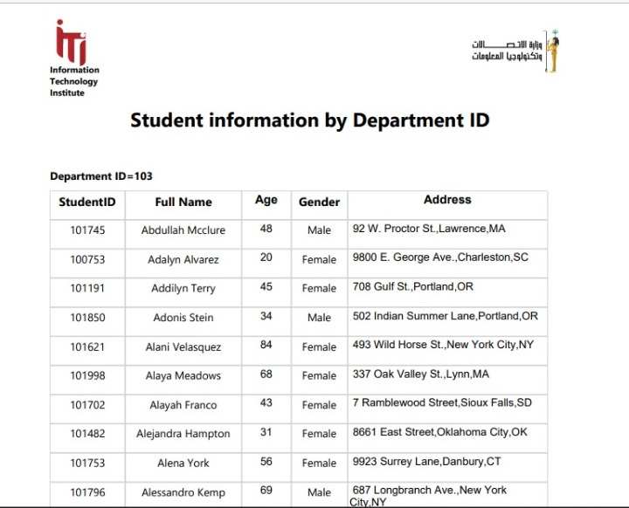
Reporting

Slide 14
Windows Applications
Login authentication
View reports
Take exams
View student results and courses
SignUp for a new student

Slide 15
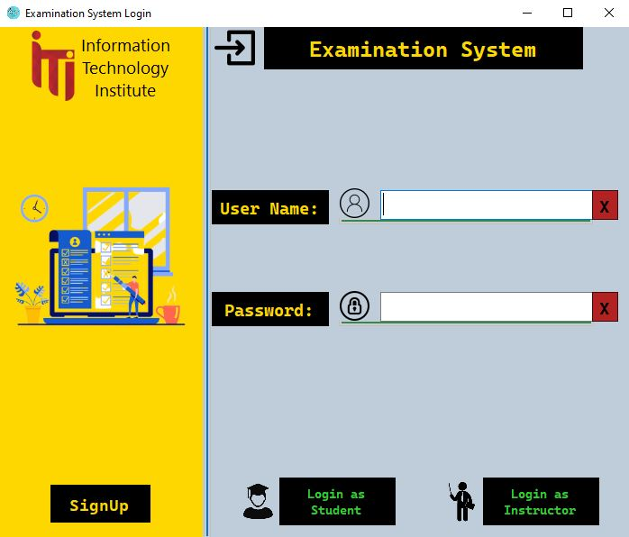
Windows Applications(Main form)

Slide 16
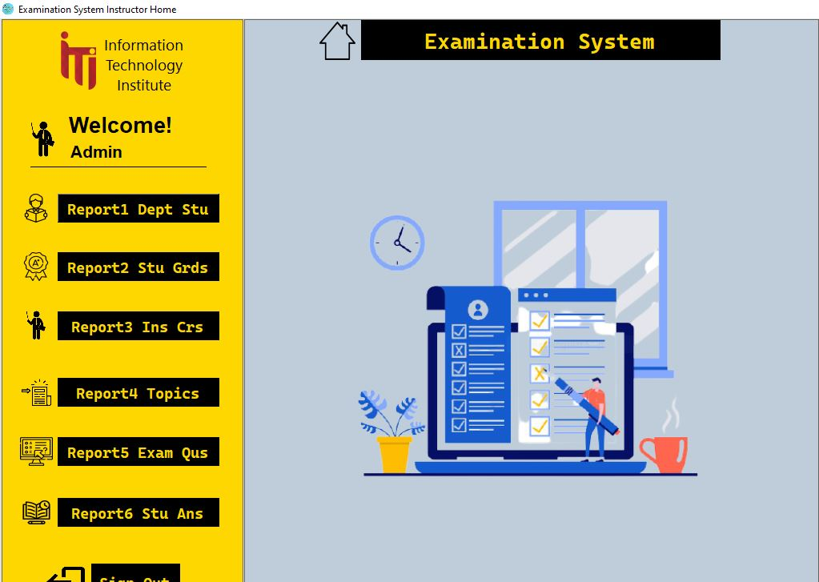
Windows Applications(Instructor form)

Slide 17
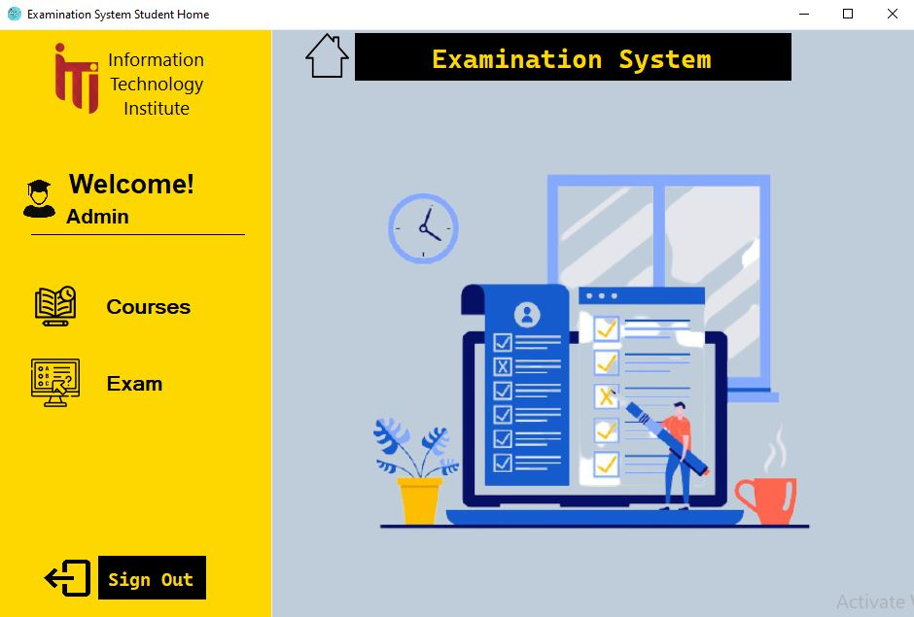
Windows Applications(student form)

Slide 18
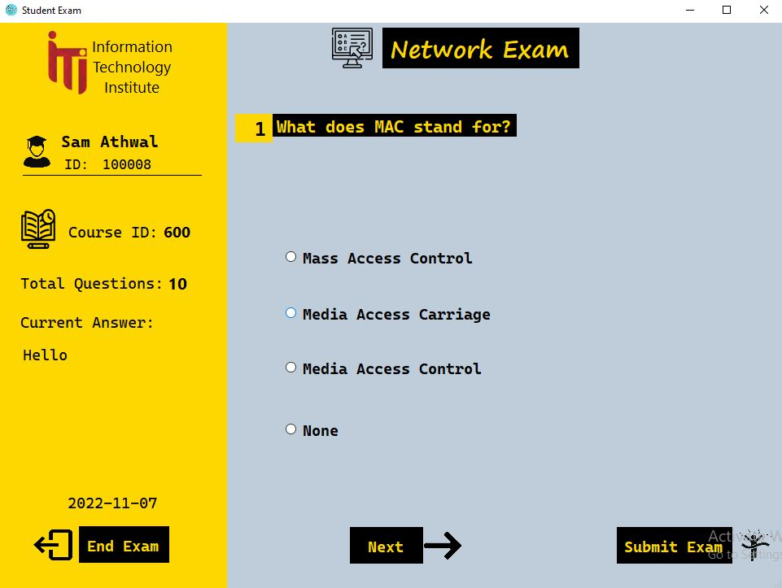
Taking Exam form

Slide 19
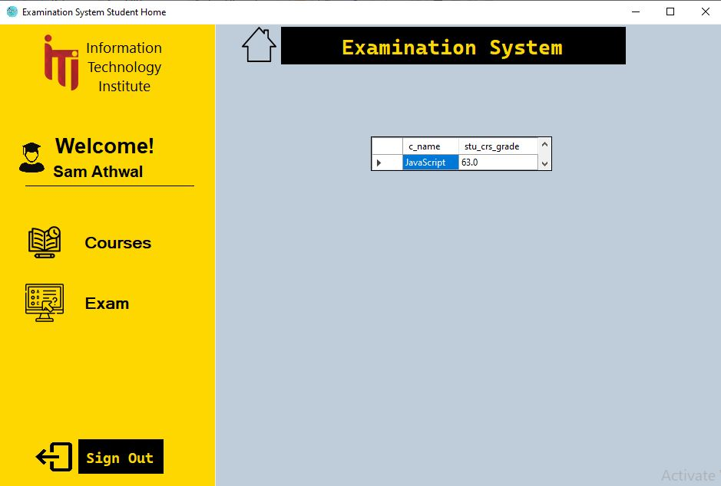
View course results

Slide 20
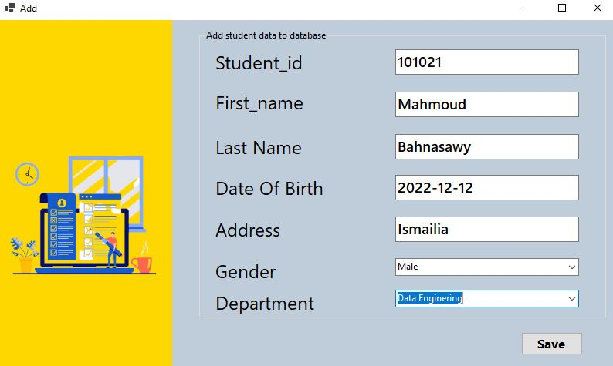
Students’s signup form

Slide 21
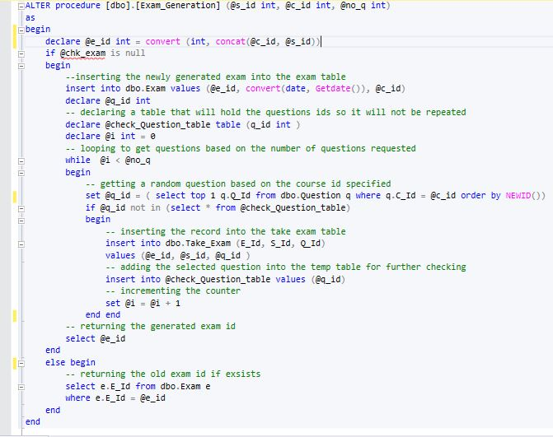
Exam generation

Slide 22
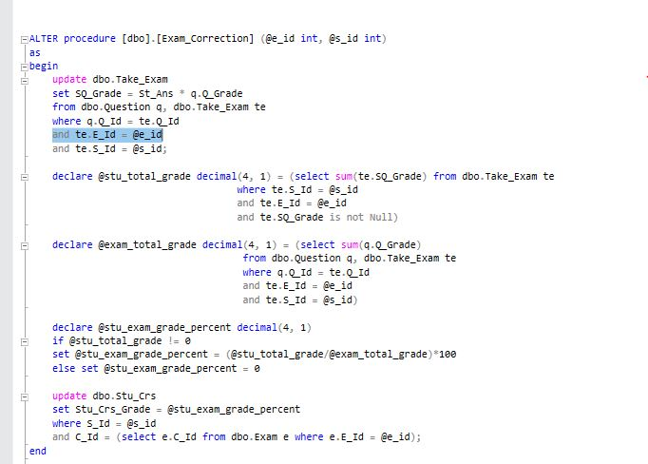
Take exam procedure

Slide 23
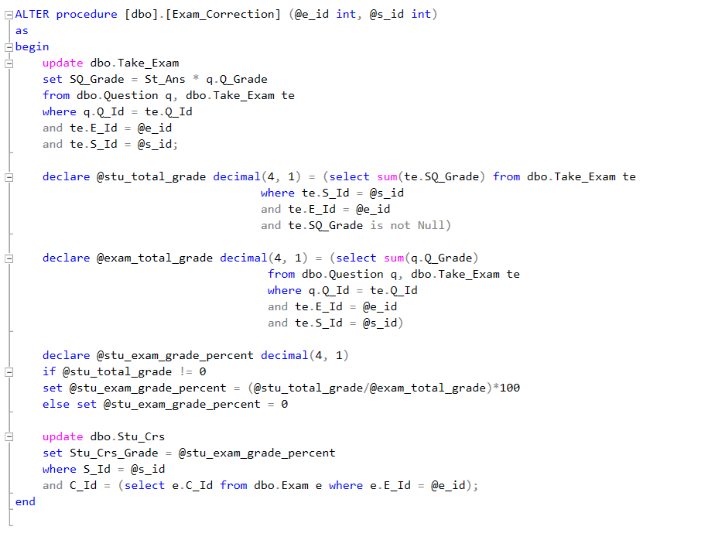
Exam correction

Slide 24
Connect desktop with reports
SSRS
Local publish
Open locally

Slide 25
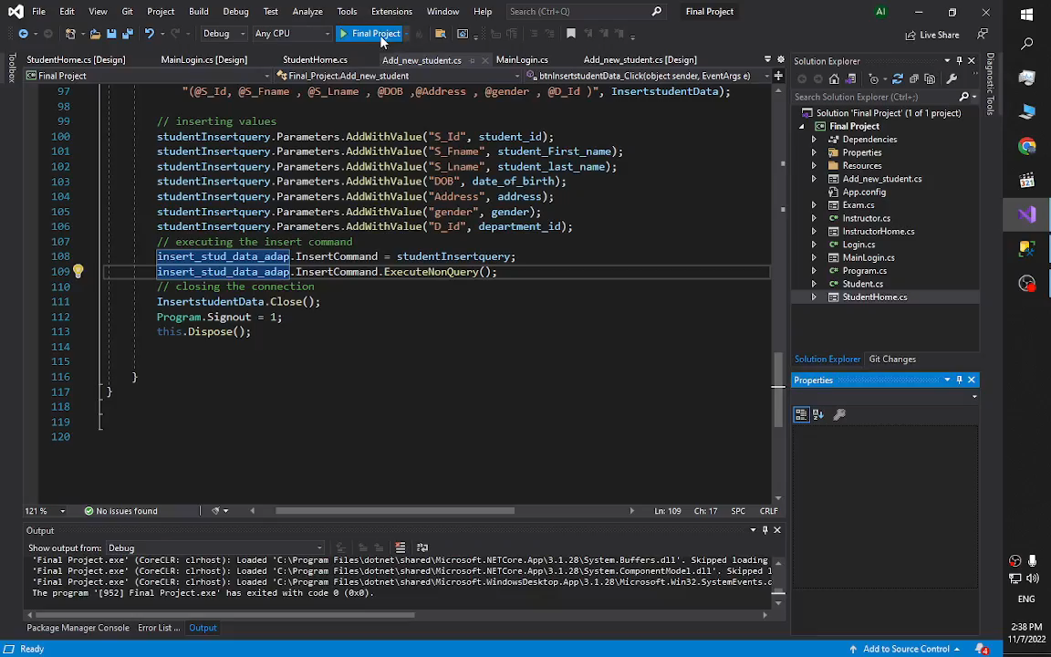
Windows application preview

Slide 26
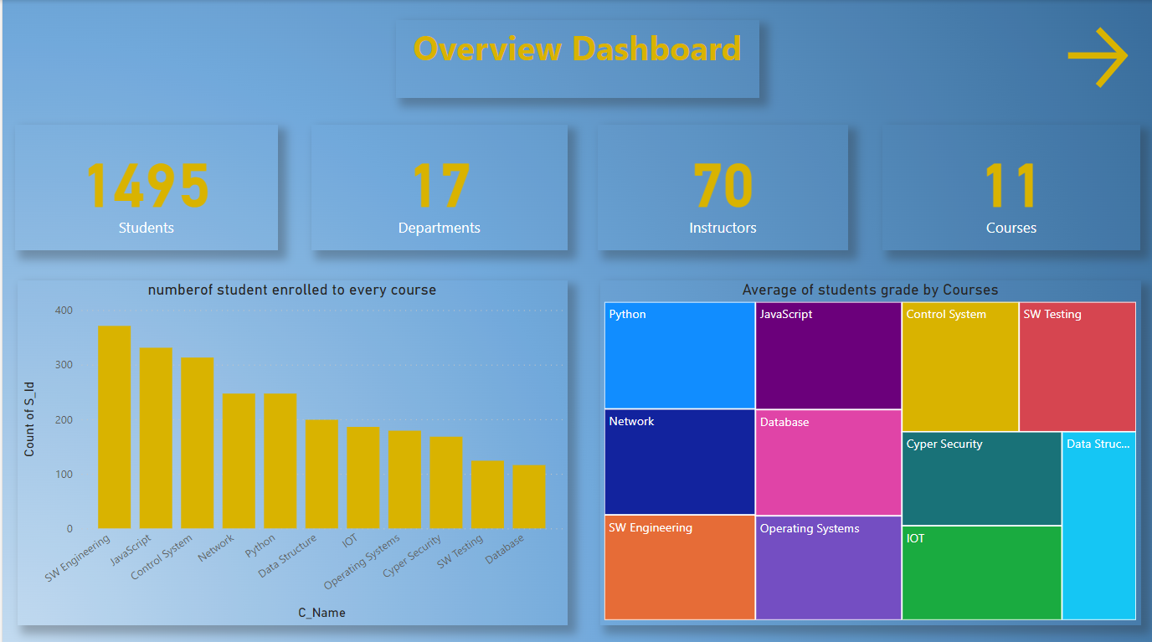
Power bi Dashboard

Slide 27
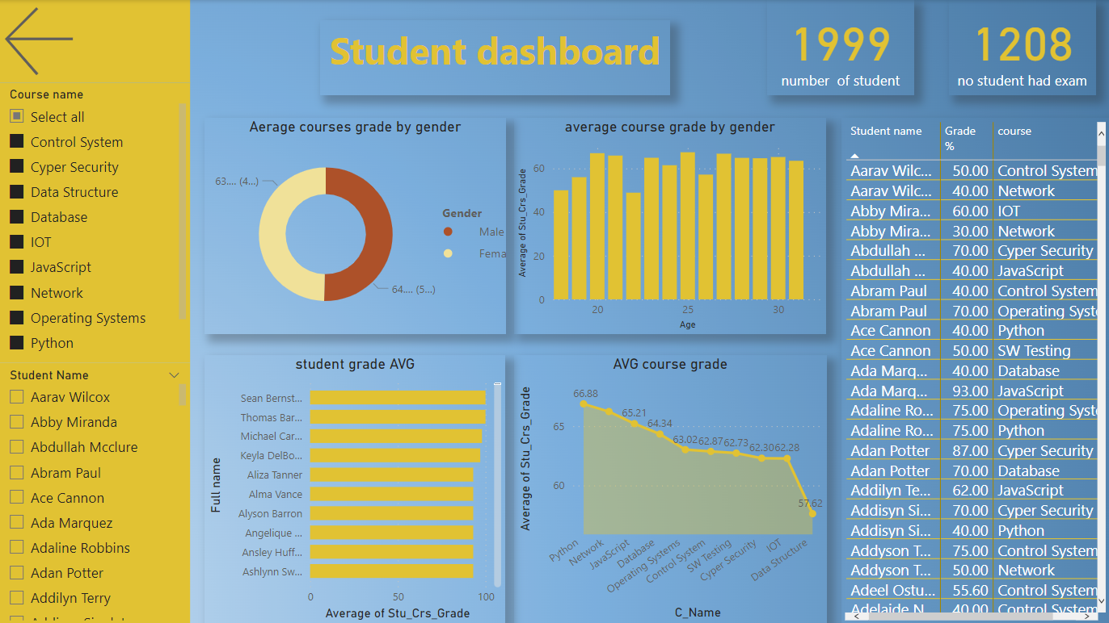
W

Slide 28
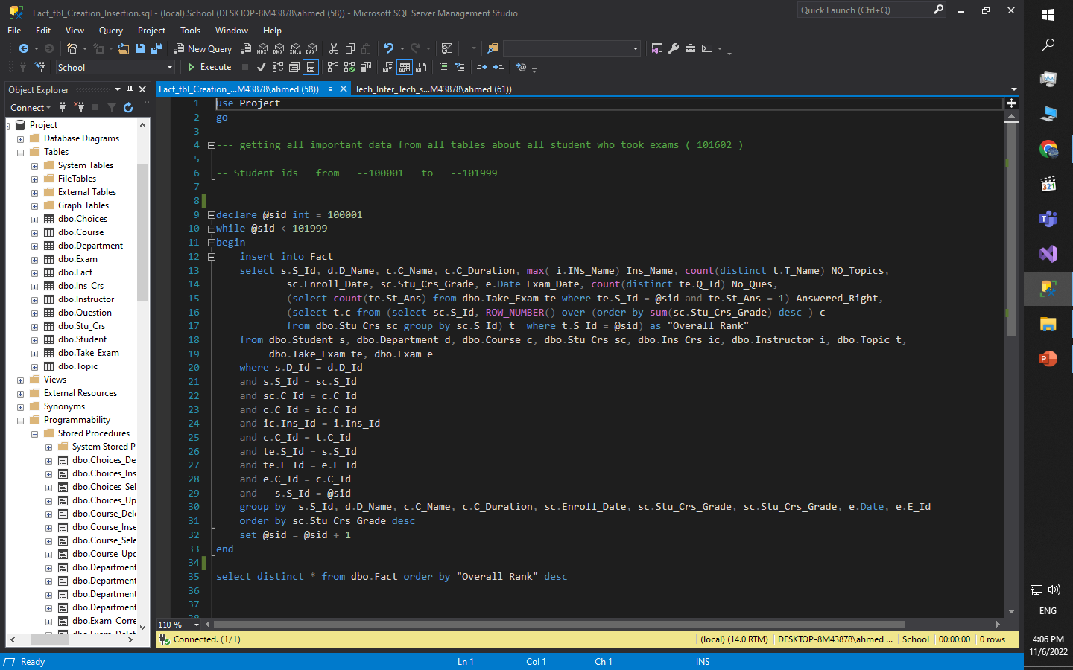
Fact Table SQL Script

Slide 29
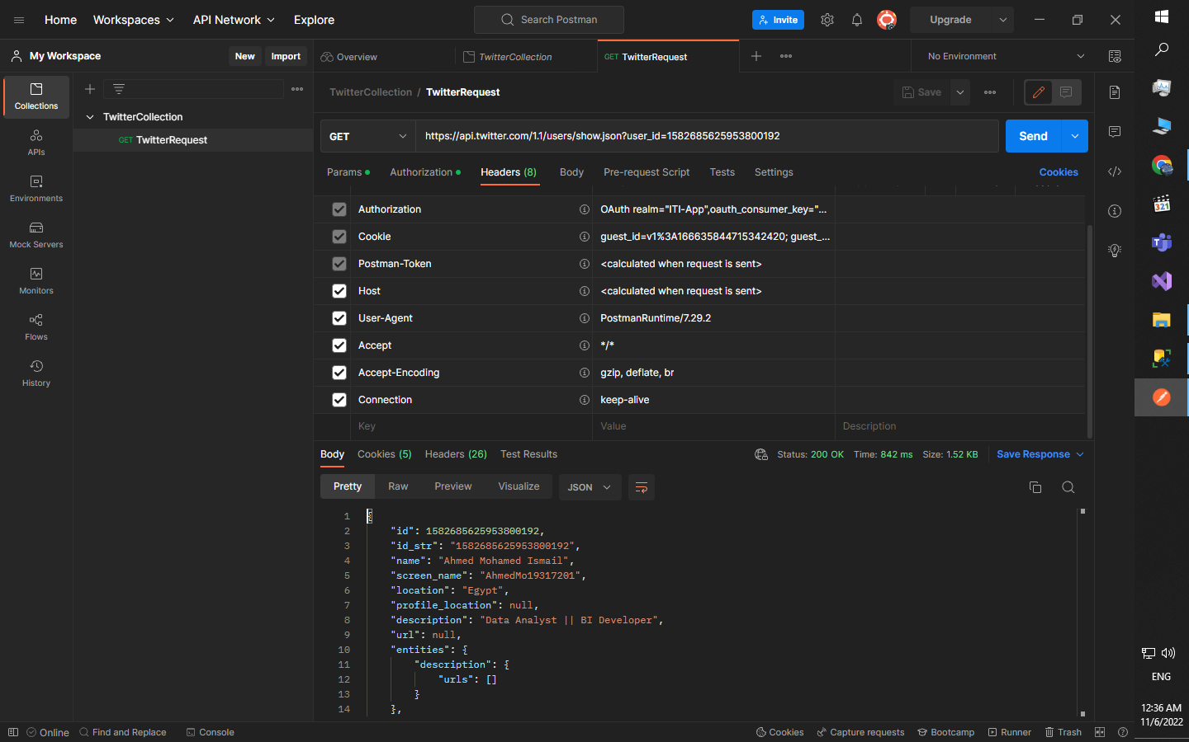
Postman API Request

Slide 30
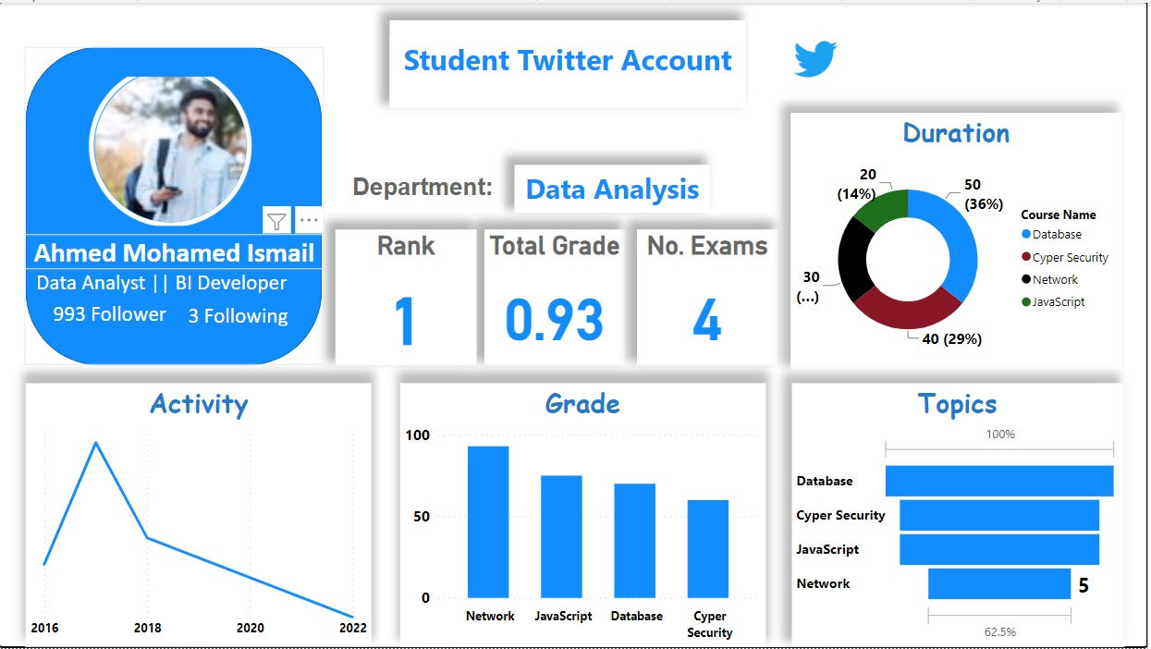
Social media Dashboard

Slide 31

THANK YOU

